Slide 1
CS310 Operating Systems Lecture 32 : File System - Introduction
Ravi Mittal
IIT Goa

Slide 2
Acknowledgements !
Contents of this class presentation has been taken from various sources. Thanks are due to the original content creators:
Book: Modern Operating Systems by Andrew Tanenbaum and Herbert Bos,
Chapter 4
Book: Linux System Programming: talking directly to the kernel and C library, by Robert Love
Book: Computer Systems, A programming Perspective, Bryant and O’Hallaron
Class presentation: University of California, Berkeley, CS162

Slide 3
Read the following:
Book: Modern Operating Systems, by Andrew Tanenbaum and Herbert Bos
Chapter 4
Book: Linux System Programming: talking directly to the kernel and C library, by Robert Love

Slide 4
We will study..
File System – Introduction
File System – Architecture – top level view
File Naming
File Structure
File Types – Regular Files
Binary Files – ELF format

Slide 5
File System - Introduction

Slide 6
Abstractions with Operating Systems
Does a user need to know about processor ?
No. We have Process abstraction
Does a user need to know about physical memory?
No. We have Process Address Space abstraction
Does a user need to know about details of disk operations and configuration etc
No. We have File system abstraction
Three Important Abstractions in OS
Process Abstraction
Address Space Abstraction
File Abstraction

Slide 7
A new abstraction: File System
An OS abstraction that provides persistent, named data
File systems are a common operating system abstraction to allow applications to access non-volatile storage

Slide 8
Disk Storage
Non-volatile Storage – for files
Disk or Flash Memory – medium to store files
Information is stored in blocks on the disks/Flash
We can read and write blocks
Henceforth – we will use term Disk to mean non-volatile storage including both Hard disks and Flash
Adapted from: Tanenbaum, Modern Operating Systems

Slide 9
Why Files ?
Many important applications need to store more information then have in virtual address space of a process
Example: banking, Corporate record keeping, etc
Process’s lifetime is limited
The information must survive the after termination of the process that was using it
For many application loss of data is not acceptable
If a process gets killed because of some reason, information should not be lost forever
Multiple processes must be able to access the information concurrently
This is possible by making information independent of address space of a single process
Adapted from: Tanenbaum, Modern Operating Systems

Slide 10
Disks - Reading and Writing
Disk can be considered as a linear sequence of fixed-size blocks with two basic operations
Read block k
Write block k
In a multiuser system, we can face following issues:
How do you find information?
How do you keep one user from reading other user’s data?
How do you know which blocks are free?
Different disks have different capacities, different speeds etc – how do you handle these differences?
How does a user know all these information?
Solution: File System
Adapted from: Tanenbaum, Modern Operating Systems

Slide 11
File System
Files are logical unit of information – Created by Processes
A Disk may contain thousands of files – usually independent of each other
Processes can read existing files and create new files
Files remain in existence not affected by process creation and termination
File must disappear only when the owner explicitly deletes it
File are managed by Operating system
File System deals with how files are
Structured
Named
Accessed
Used
Protected
Implemented, and
Managed
Adapted from: Tanenbaum, Modern Operating Systems

Slide 12
File Systems – User’s perspective
What constitutes a file?
How files are named?
How files are protected?
What operations are allowed on files?
Adapted from: Tanenbaum, Modern Operating Systems

Slide 13
File System Architecture – Top View

Slide 14
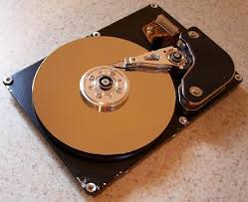
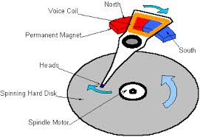
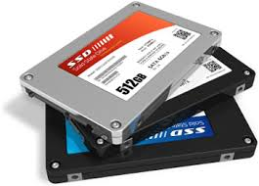

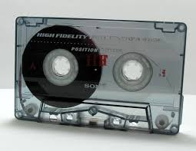
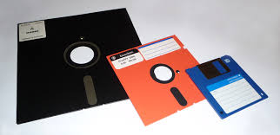
I/O and Storage Layers
Application / Service
High Level I/O
Streams
Low Level I/O
File Descriptors
We will study
Syscall
open(), read(), write(), close(), …
Open File Descriptions
File System
Files/Directories/Indexes
I/O Driver
Commands and Data Transfers
Disks, Flash, Controllers, DMA
CS 162, Univ of California Berkeley

Slide 15
File Naming

Slide 16
File Naming
File is an abstraction mechanism
A way to store information on disk and later read it back
Writing and Reading file information should be done in a way that disk operation (where information is stored etc) details are not visible to users
The most important characteristic of any abstraction is
Naming of objects
When a process creates a file – it gives it a name
When the process terminates, the file remains
It can be used by other processes
Adapted from: Tanenbaum, Modern Operating Systems

Slide 17
File Naming
Naming conventions vary from system to system
One to 8 letters in all current OS’s
Many file systems allow up to 255 characters
Many OS support
Two part names
Exp: prog.c
File extension: part after period - Tells something about the file
Adapted from: Tanenbaum, Modern Operating Systems

Slide 18
Aside - Different File Systems
FAT 16: MS-DOS, Windows 95
FAT 32: Windows 98, Windows NT, Windows 2000, Windows XP
Obslete now
NTFS ( Native File System)
Latest Windows: 11, 10, 8.1 and MS Servers
Linux
The Resilient File System (ReFS)
Microsoft’s newest file system
BlueStore / Cephfs
Linux
APFS
Apple
EROFS
Android

Slide 19
Question! Find the answer !
Can an OS support multiple file system?
If so, how?

Slide 20
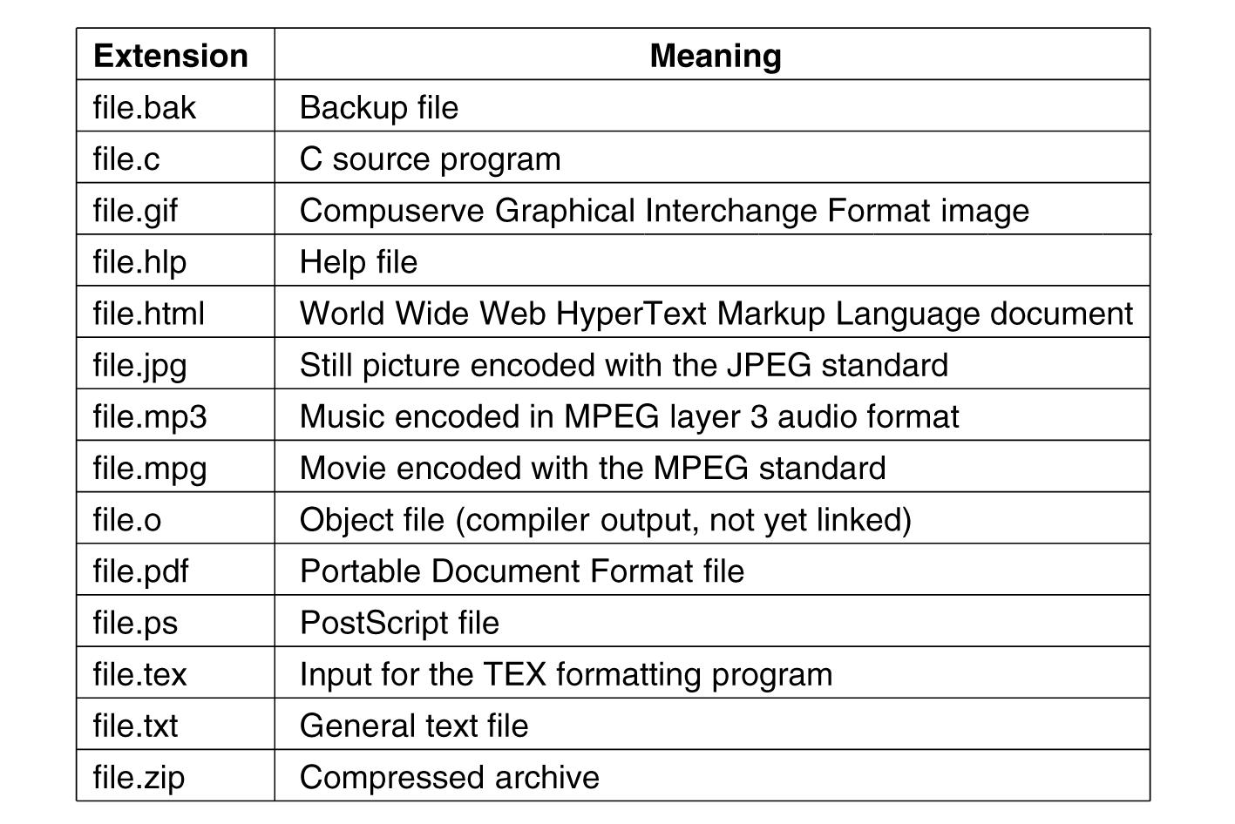
Suffix Examples
Adapted from: Tanenbaum, Modern Operating Systems

Slide 21
File Name – More info
In Unix, the size of the extension is up to the user
File may have two or more extensions
Example: homepage.html.zip
In Unix, extensions are just conventions
Not enforced by the OS
A C compiler may actually insist that file to be compiled must end in .c
Windows OS is aware of extensions
Assigns meaning to the extensions
→ Which program must be executed when you double click on a file
Double click on file.docx will start Microsoft Word

Slide 22
File Structure

Slide 23
File Structure – Three categories
Byte sequences
Maximum flexibility-can put anything in
Unix and Windows use this approach
Byte stream
Fixed length records (card images in the old days)
Read/Write operations are done on one record
Example: Based on Punch cards (80 columns) – record 80 characters
Not in use
VMS OS provides highly structured file – with records
Tree of records- uses key field to find records in the tree
Tree is sorted on the key field
Used in some large mainframes
In use
Obsolete
Obsolete
Adapted from: Tanenbaum, Modern Operating Systems

Slide 24
File Structure – Three Types
Bye
sequence
Record
sequence
Tree
Adapted from: Tanenbaum, Modern Operating Systems

Slide 25
File Structure – Three Types
Bye
sequence
Record
sequence
Tree
Our focus
Adapted from: Tanenbaum, Modern Operating Systems

Slide 26
File Structure – Byte Sequence
Unstructured sequence of bytes
OS doesn’t know what is in the file
Used in Unix , Windows, Linux
Extremely flexible way of designing files
User programs can put anything they want in their files and name them – as they want
OS does not enforce semantics of file contents
Remember analogy of the Internet
It’s just a pipe – it doesn’t enforce any semantics to data being carried in packets

Slide 27
File Types

Slide 28
File Types
Regular Files (most common)
Text
Binary
Directories
A file that contains the names and locations of other files
Character Special and Block Special Files
Terminals (character special) and disks (block special)
FIFO (named pipe)
A file type used for inter-process communication
Socket
A file type used for network communication between processes
Adapted from: Tanenbaum, Modern Operating Systems

Slide 29
Regular Files
What we mostly call as files – are regular files
Regular files contain bytes of data organized into linear array called a byte stream
Linux has no further organization or formatting specified for a file
Any byte within a file can be read or written to
Read or write operation start at a specific byte
Conceptual location
File position or file offset
Essential metadata
At file opening – file position is zero
Adapted from: Linux System Programming : Robert Love

Slide 30
Regular Files (Linux)
File reading or writing is done byte by byte
The file position increases
File position may be set manually
File position starts at zero
Writing a byte to the middle of a file overwrites over the previous byte
It is not possible to expand a file by writing into middle of it
Adapted from: Linux System Programming : Robert Love

Slide 31
Regular Files (Linux)
File position’s maximum value
OS specific
Size of a file: length in bytes
A file’s length can be changed by truncation
Truncation to size smaller than original: Causes bytes removed from the end
Truncation to size larger than original: Causes bytes added at the end – filled with zeros
A file may be empty – contains no valid bytes
Adapted from: Linux System Programming : Robert Love

Slide 32
Regular Files (Linux)
A single file may be opened more than once
By the same process or different processes
Each open instance of a file gives a unique file descriptor
Processes can share their file descriptors
No restriction on concurrent file accesses by multiple processes
If concurrent reading and writing is happening
Result may be unpredictable
So user processes must coordinate
Files are associated with file names but they are referenced by inode – information node
Inode is assigned an integer value unique to the file system – inode number or i-number
Adapted from: Linux System Programming : Robert Love

Slide 33
Regular Files (Linux)
i-node number
Stores metadata associated with the file
Owner, modification timestamp, type, length, location of the file’s data (but no file name)
i-node is
A physical object – located on disk (in Unix style filesystem)
Conceptual entity – represented by a data structure in the linux system
Adapted from: Linux System Programming : Robert Love

Slide 34
File Types – Regular Files - Text
ASCII files
Lines of text
Lines are terminated with a carriage return character or line feed character (or both – as in Windows)
Lines need not be of the same length
ASCII files an be edited, displayed and printed
Can be used for input or output of a program
Can use pipes to connect programs if they produce/consume ASCII

Slide 35
File Types – Regular Files - Binary
Binary files have some internal structure
Known to programs that use them
Unix - Examples of Binary Files
Executable File Formats Library procedures (modules) that are compiled but not linked
ELF: Executable and Linkable Format
Standard le format for executables, object code, shared libraries, and core dumps
There are other formats as well: a.out, COFF, PE, Mach-O, COM, ...

Slide 36
Lecture Summary
File system (User Perspective)
a collection of files and directories
Operations
Files can be
Created, deleted, Read, written
Files are named
Extension after period – tells us about the file
Files types
Regular: Text and Binary
Directories
Block Special Files
Binary Executable and Linkable file: ELF file format

